Slide 1
LOUIS H. SULLIVAN
BY Ansiya & Leema

Slide 2
Louis sullivan
Louis H. Sullivan (1856-1924) was one of the most influential architects to come out of the Chicago School of architecture in the late 1800s. He is often called the “father of the skyscraper”, the “prophet of modern architecture” and conceived the most famous phrase ever to come out of his profession, “form follows function” (or, more accurately, “form ever follows function”). Among his most outstanding surviving works are the Auditorium Theater, the Carson, Pirie Scott department store, and the Charnley House in Chicago, the Wainwright Building and Union Trust Building in St. Louis, the Guaranty Building in Buffalo, New York, and eight small “Jewel Box” banks that are among the most treasured pieces of historic architecture in the United States.

Slide 3
Louis Sullivan was committed to establishing an authentic, American style of architecture, free of historic imitations
Louis Sullivan’s architecture is a mixture of plain geometry and undisguised massing punctuated with elaborate pockets of ornamentation in stone, wood and terra cotta.

Slide 4
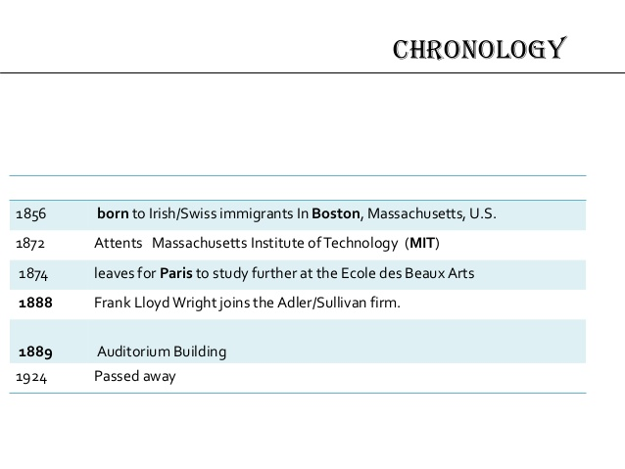

Slide 5
Sullivan’s philosophy

Slide 6
“form follows function”

Slide 7
LAW
"It is the pervading law of all things organic and inorganic, of all things physical and metaphysical, of all things human and all things superhuman, of all true manifestations of the head, of the heart, of the soul, that the life is recognizable in its expression, that form ever follows function”

Slide 8
EXPLANATION
Architecture, is the following: the form of a building should take its cue from the manner in which that building will be used (its function). To him, this is an observable principle of nature, a principle that we should use to inform the things that we as humans make as well. Sullivan proposes that, since this is a concept that has worked so well in nature (and even we are evidence of this success), it makes perfect sense to apply it to architecture as well. Expanding on this point, Sullivan says that in order to determine what form the building should take, one must consider how that building will be used, dividing it into specific functions which vary according to location within the building

Slide 9
He outlines these: a basement, for boilers, pipes and other mechanical features; the first floor will likely be used for commercial space, shops, and also needs a central entrance which is easy to locate and navigate; the floor above this for other commercial space; above that one, an inordinate number of floors dedicated to office spaces, uniform in nature and compartmentalized; and an attic space for additional mechanical necessities. Thus, it would naturally follow, says Sullivan, that the first two floors will be considerably loftier in height than the floors above it for office spaces, the office floors need not be different from each other, and so on. In short, the form of the building should be derived from how the building and its various components will be used. If designed in this manner, the final form will “just make sense,” as do things we see in nature

Slide 10
HIS STYLES
His commonly used styles was “CHICAGO STYLE” and “AMERICAN STYLE”
If we review the characteristics of his Style, the most important items were as follows:
Use of new material, new building techniques
Elimination of historical ornaments
Inventive and fresh surface decoration
Expression of structure
Abundance of antique styles
Expression of building’s commercial purpose: FUNCTION

Slide 11
HIS DESIGN

Slide 12
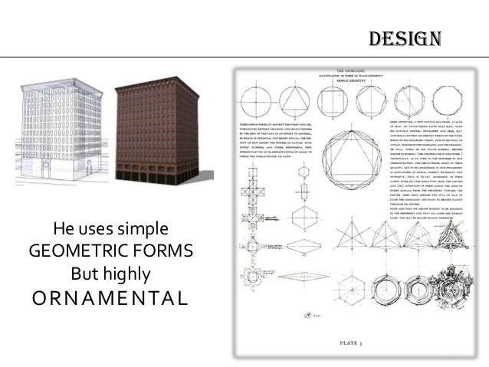

Slide 13
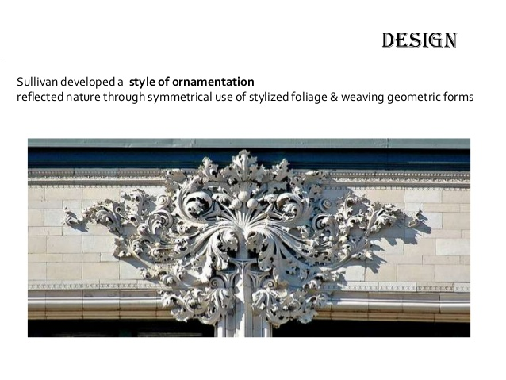

Slide 14
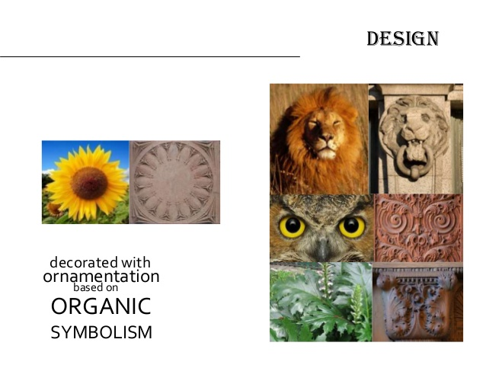

Slide 15
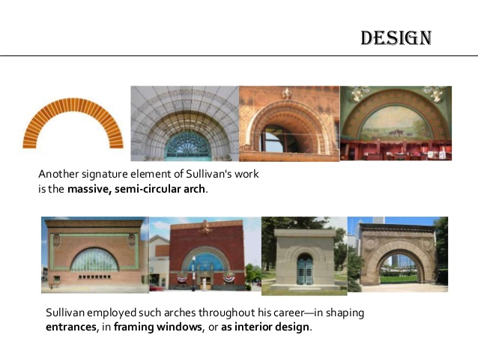

Slide 16
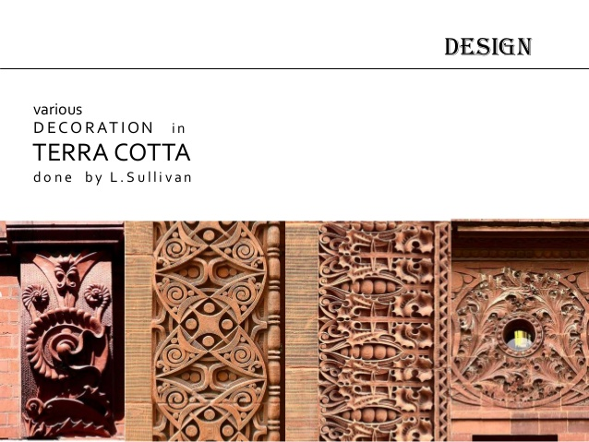

Slide 17
HIS FAMOUS WORKS

Slide 18
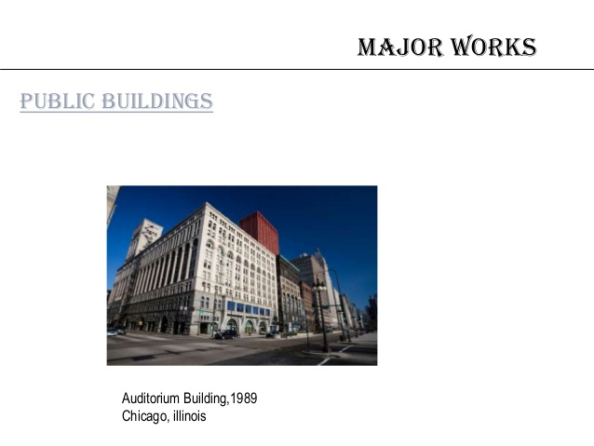

Slide 19
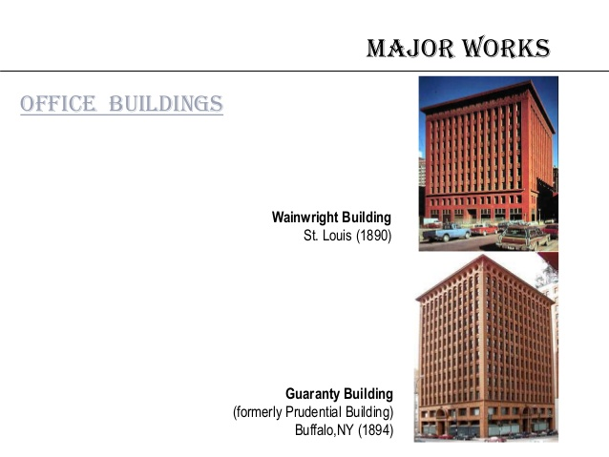

Slide 20
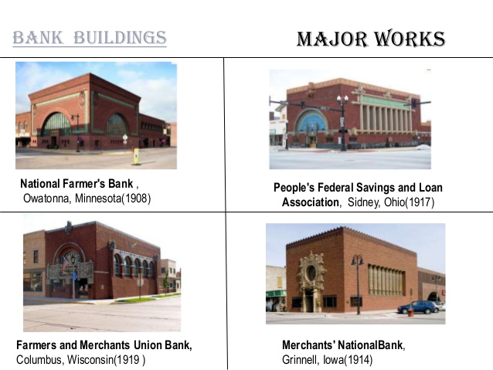

Slide 21
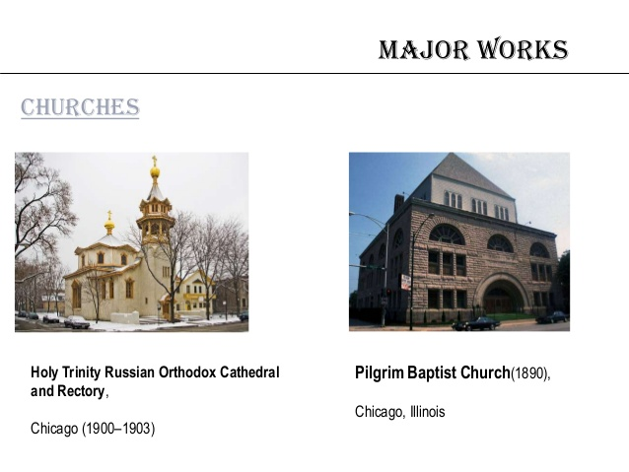

Slide 22
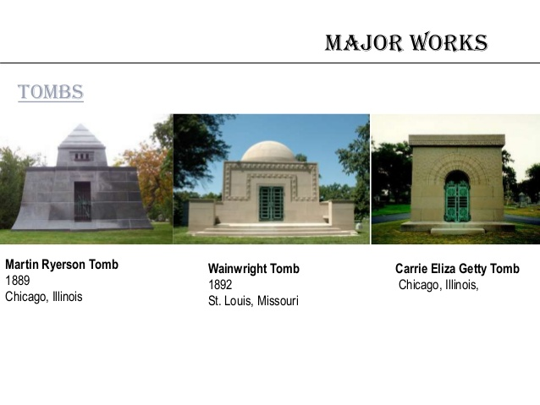

Slide 23
GUARANTY BUILDING

Slide 24
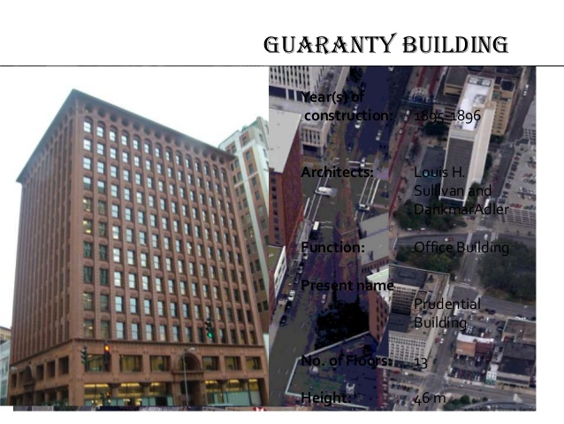

Slide 25
The Guaranty Building, now called the Prudential Building, was completed in 1895. It is recognized internationally as one of the masterpieces of Louis Sullivan, probably one of the most important American architects of the 19th century and known nowadays as the "father of the skyscraper."In the 1890s skyscrapers were nine types of building and unequivocal American. Most of the first skyscrapers, including some of the neighboring building designs Guaranty utitizaron European compositions with strong horizontal facade to de-emphasize its verticality. Known styles were used for a completely new type of building.
Sullivan wanted a completely new architecture for this new type of constructions expressing security and prosperity of the United States at the end of XIX century. Discard the traditional designs and welcomed the verticality of the skyscraper. Guaranty Building is an outstanding example of innovation Sullivan.
This building marks the beginning of a distinctly American architectural style

Slide 26
MEANING
The building illustrates Sullivan's famous phrase that read: "The forms continue to function." Terracotta ornaments, for example, emphasize the internal structure of the building.
We could go one step further and even dare to crack the facade of the building as a reflection of one of the inventions that enabled the birth of the skyscraper and articulate these works, the elevators.Some say that Sullivan did not dare to introduce technological innovations in front which was equipped with the skyscrapers and that's why the facade ornamentation with floral motifs, and so on.
Yet another reading can be done almost opposite. The eye-shaped windows on the top floor of the pulleys reflect the elevator machinery that is precisely this level of the building. The vertical lines that generate the composition of the facade are merely the representation of the steel cables that run the building up and down through the pulleys at the top floor lifts allowing travel on its vertical axis. The building becomes a skyscraper in motion. This is also the best representation of the concept without words above "forms follow function" and that the forms of the facade is only a reflection of the internal functions of the building.

Slide 27
SPACES
The building is in its facade and its design, reflecting the role that is required, as the office block will have a basement boiler and driving elements, and under the first floor, which used to trade, are bright and spacious, with very showy entrance, the upper floors are office lighting with certain characteristics, but all the same, so abroad, with varying degrees of ornament, it should be noted that equality, all ending in a penthouse crown, for maintenance services and equipment which, not being offices need not adhere to the above characteristics. Plant in the building forms a "U" creating an inner courtyard. The offices are light or by itself or by the front courtyard which took in tone to the white light is reflected and reaches every corner.

Slide 28
STRUCTURE
As a main feature of the new architecture of the skyscrapers in the steel structure was built based on different profiles rolled section.
The entire structure is a material with fire retardant coating to protect against possible fires. Recall that at the time the great fire of Chicago was still present in everyone's mind.

Slide 29
MATERIALS
The structure was built entirely of steel.
In front are the predominant materials terra level (one of the favorite materials of Sullivan and other architects of the time) and the ornament of the glass windows.

Slide 30
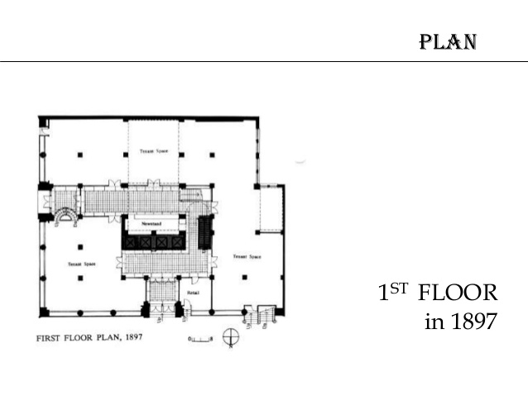

Slide 31
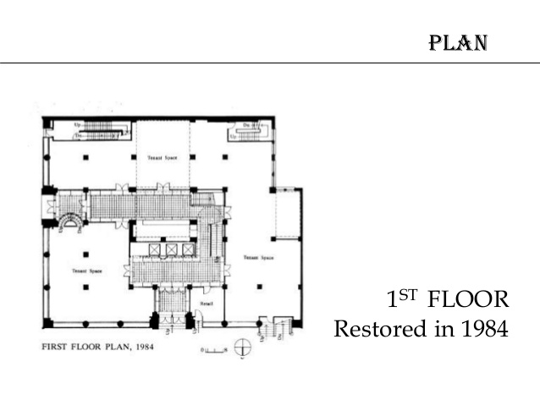

Slide 32
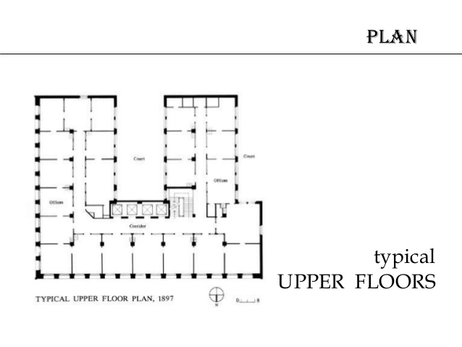

Slide 33
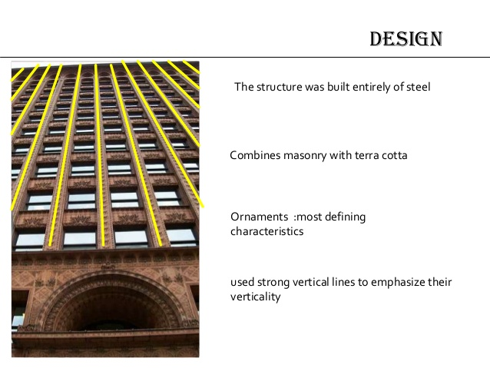

Slide 34
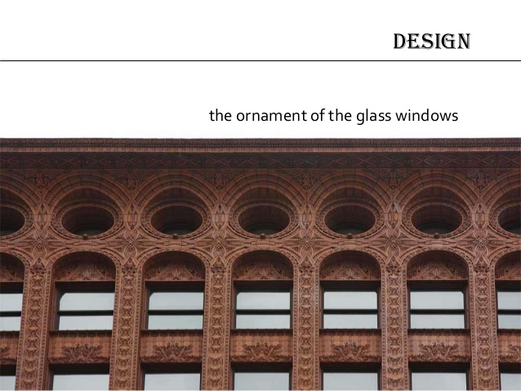

Slide 35
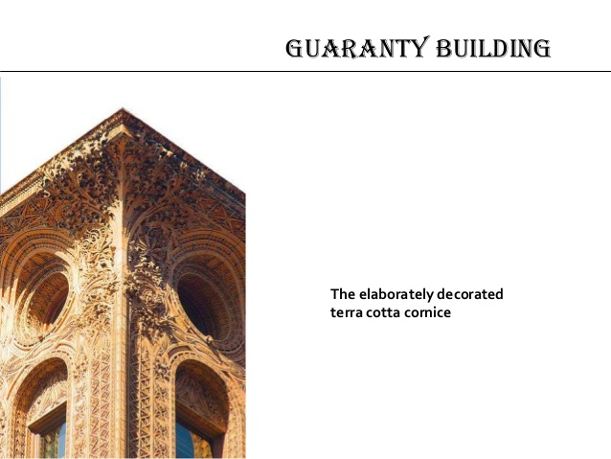

Slide 36
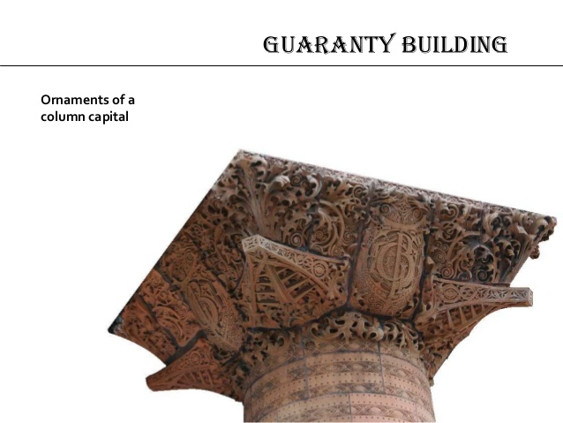

Slide 37
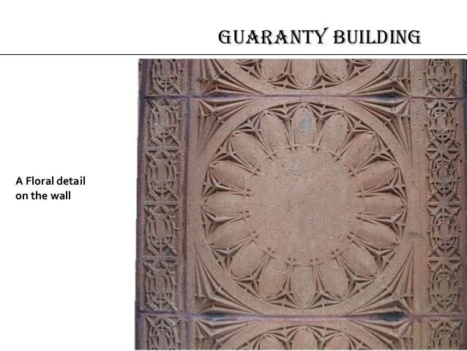

Slide 38
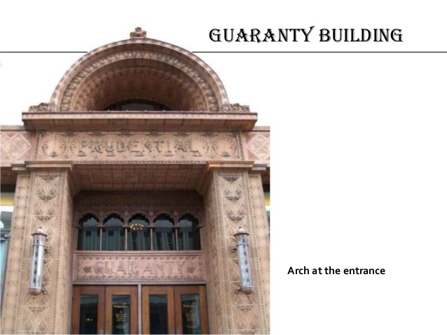

Slide 39
Wainwright Building

Slide 40
Wainwright building
The Wainwright Building (also known a the Wainwright State Office Building) is a 10-story red brick office building at 709 Chestnut Street in downtown St. Louis, Missouri
the Wainwright Building was designed by the famed architects Adler and Sullivan in 1891. The Wainwright building is credited for being the first successful utilization of steel frame construction. The first two floors are faced in brown sandstone, the next seven stories rise in continuous brick piers. Terra cotta panels of ornate foliage relief's decorate the each floor. The tenth story is a frieze of intertwined leaf scrolls framing circular windows, and is capped with Sullivan's characteristic overhanging roof slab. The building became a City Landmark in 1972. The Wainwright building is also a National Historic Landmark.

Slide 41
As designed, the first floor of the Wainwright Building was intended for street-accessible shops, with the second floor filled with easily accessible public offices. The higher floors were for "honeycomb" offices, while the top floor was for water tanks and building machinery.

Slide 42
ARCHITECTURE
Aesthetically, the Wainwright Building exemplifies Sullivan's theories about the tall building, which included a tripartite (three-part) composition (base-shaft-attic) based on the structure of the classical column and his desire to emphasize the height of the building. He wrote: "[The skyscraper] must be tall, every inch of it tall. The force and power of altitude must be in it the glory and pride of exaltation must be in it. It must be every inch a proud and soaring thing, rising in sheer exultation that from bottom to top it is a unit without a single dissenting line." His 1896 article cited his Wainwright Building as an example.Despite the classical column concept, the building's design was deliberately modern featuring none of the neoclassical style that Sullivan held in contempt

Slide 43
The ornamentation for the building includes a wide frieze below the deep cornice ,which expresses the formalized yet naturalistic celery-leaf foliage typical of Sullivan and published in his System of Architectural Ornament, decorated spandrels between the windows on the different floors and an elaborate door surround at the main entrance. "Apart from the slender brick piers, the only solids of the wall surface are the spandrel panels between the windows..... They have rich decorative patterns in low relief, varying in design and scale with each story." The frieze is pierced by unobtrusive bull's-eye windows that light the top-story floor, originally containing water tanks and elevator machinery. The building includes embellishments of terra cotta a building material that was gaining popularity at the time of construction.

Slide 44
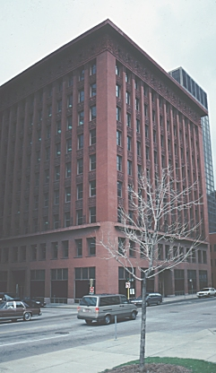
The pilasters soar upward from above the base to the cornice. Still, the ornament of the recessed spandrels gives a sense of horizontality, suggesting the floors of the building.

Slide 45
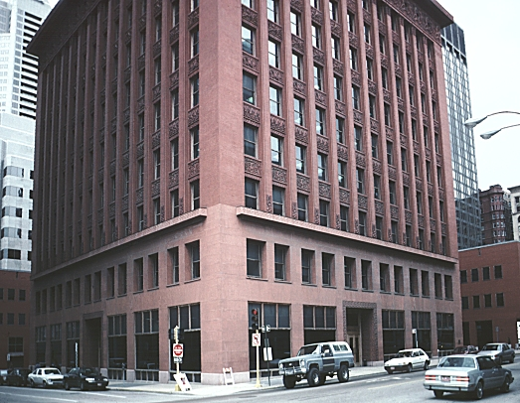
Sullivan's architecture typically uses a base or podium, then the shaft, and terminates in a heavy cornice.

Slide 46
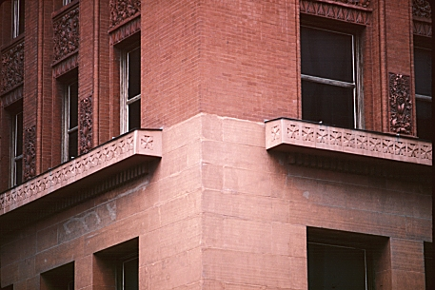
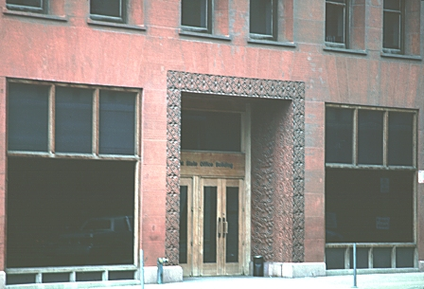
Details of the corner at the podium level and the entrance

Slide 47
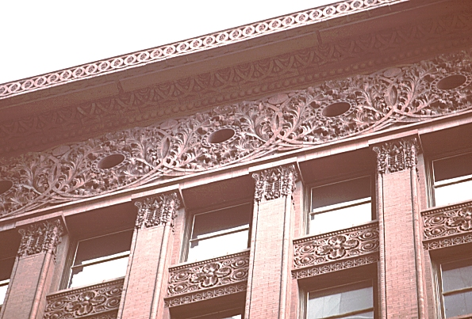
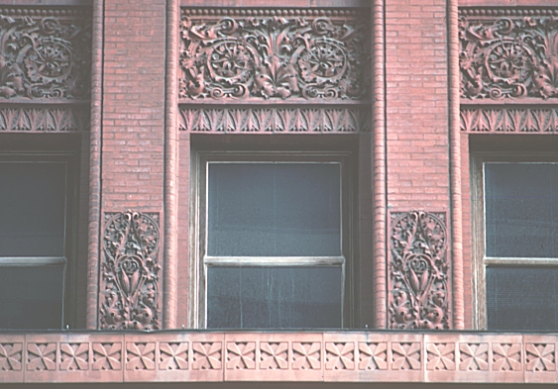
Details of the windows and the top

Slide 48
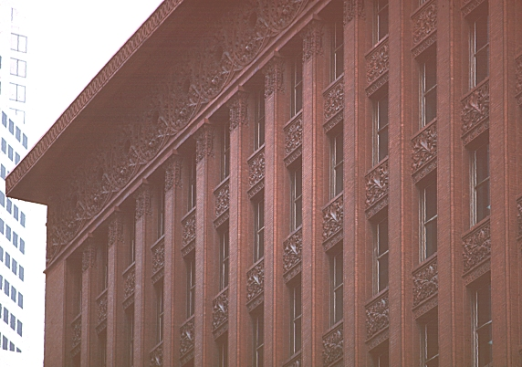
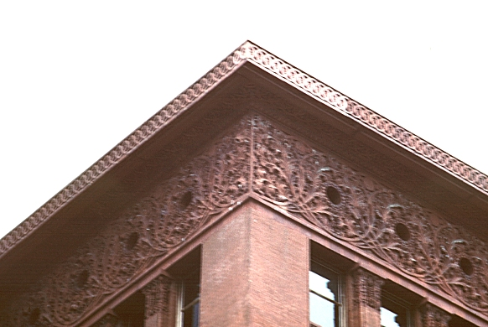
The top and the cornice

Slide 49
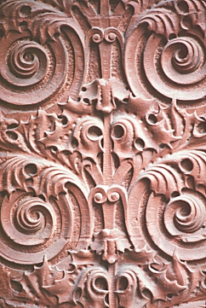
The organic decoration at the entrance

Slide 50
THANK YOU

